Slide 1
Module 3 - constructors

Slide 2
Constructors
A constructor initializes an object when it is created.
It has the same name as its class and is syntactically similar to a method, but constructors have no explicit return type.

Slide 3
Types of constructors
Default constructor (no-arg constructor)
Parameterized constructor

Slide 4

Default constructor
Syntax

Slide 5
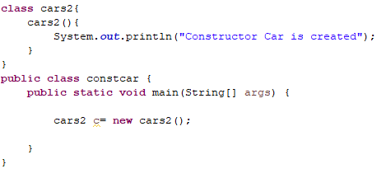
Example 1

Slide 6
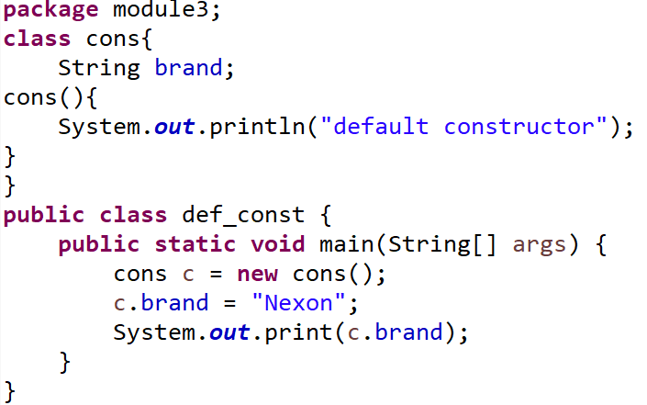
Example 2

Slide 7
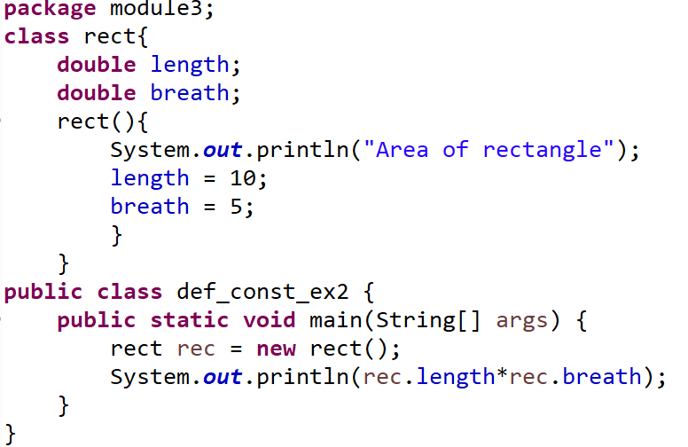
Example 3

Slide 8
Parameterized constructor
A constructor which has a specific number of parameters is called a parameterized constructor.

Slide 9
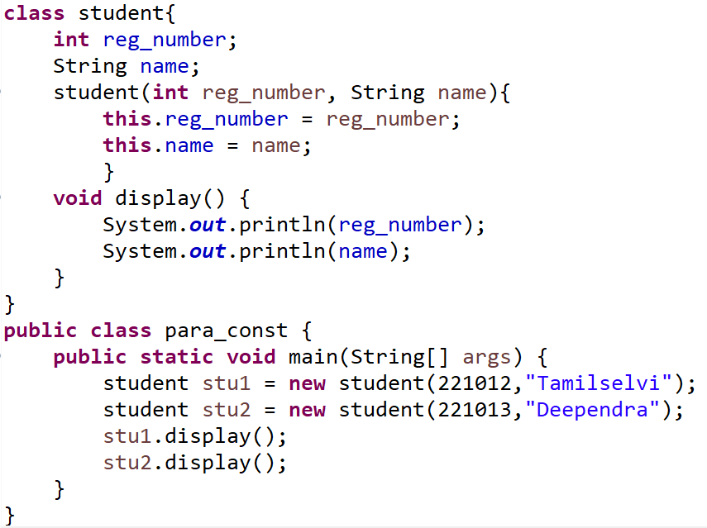
Example 1

Slide 10
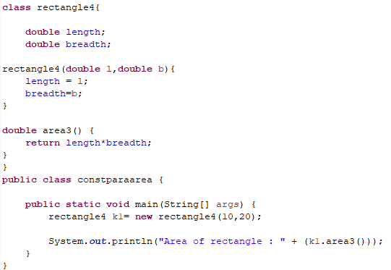
Example 2

Slide 11
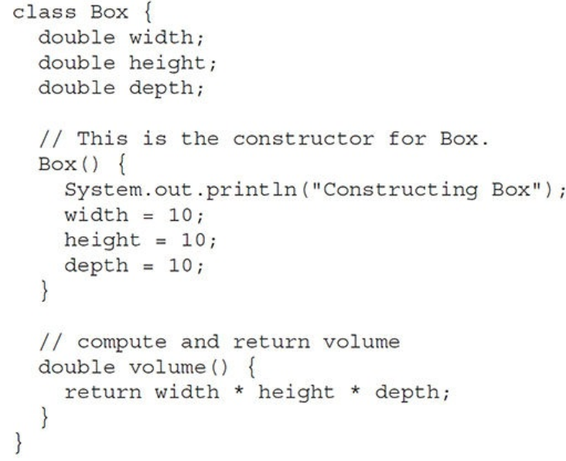
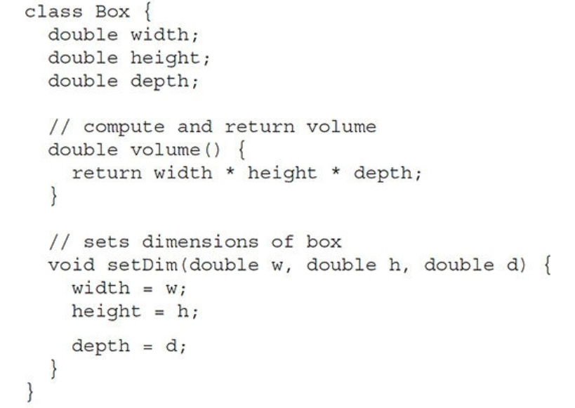
Example 1: With and Without constructors
Constructor
No Constructor

Slide 12
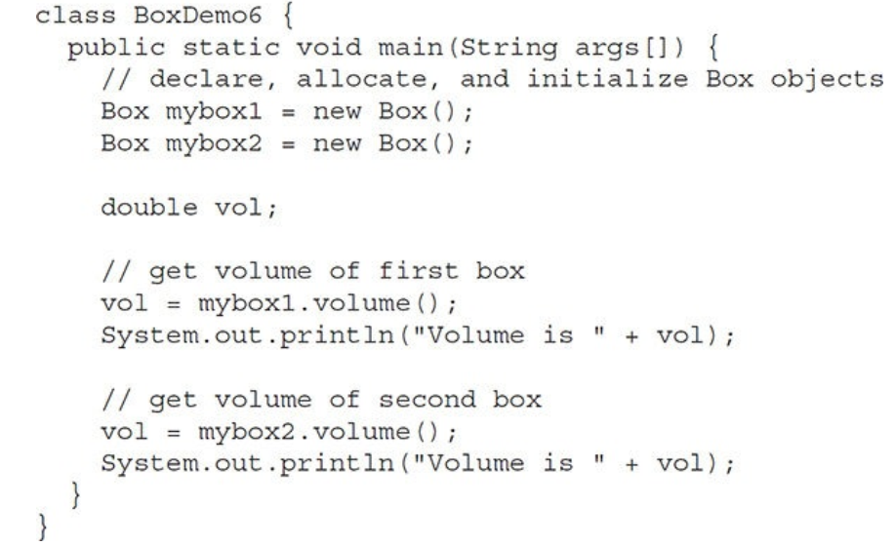
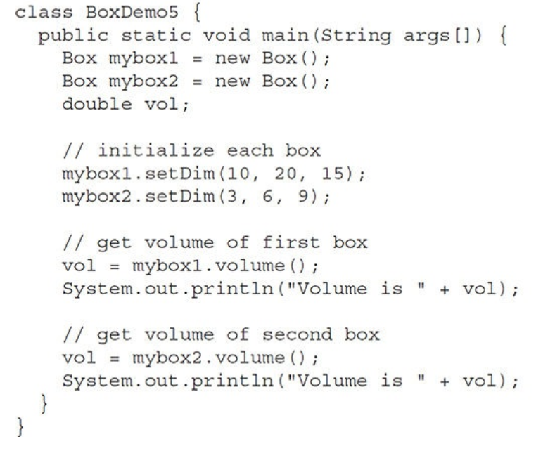
Constructor
No Constructor

Slide 13
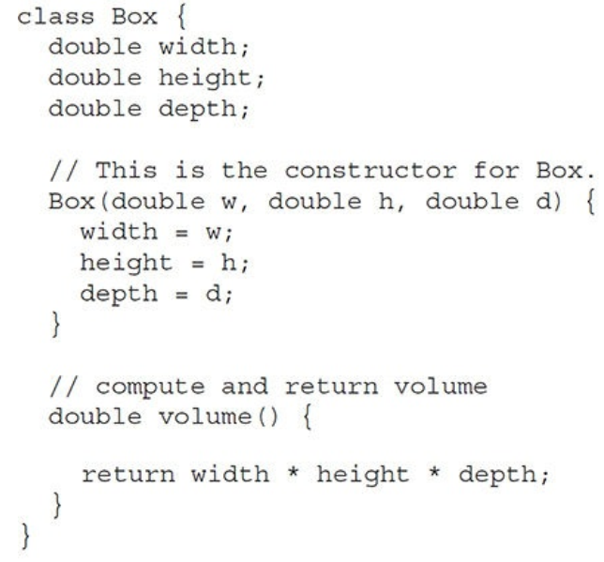
Example 2: With and without constructor
Parameterized Constructor
No Constructor

Slide 14
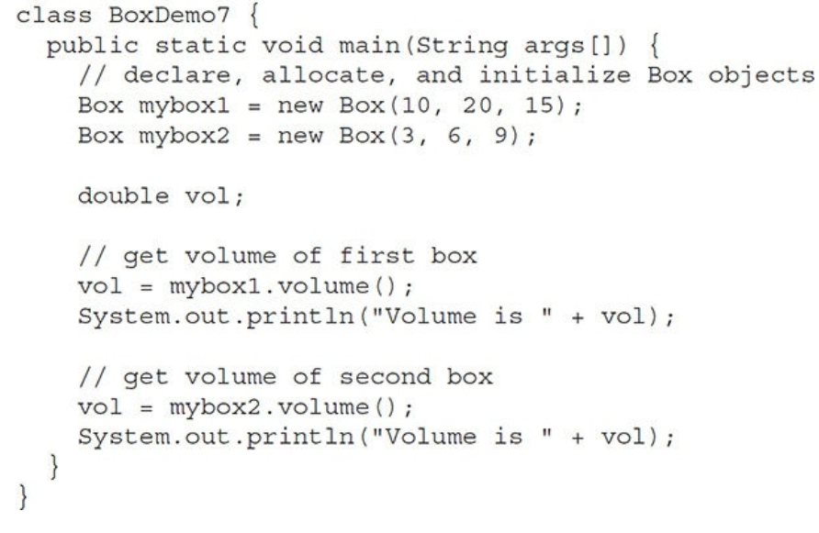
Parameterized Constructor
No Constructor

Slide 15
destructors
In programming, a destructor is a method called when an object is destroyed, typically to release resources like memory, file handles, or network connections.
In languages like C++, destructors are explicitly used to manage resource cleanup.
However, Java takes a different approach due to its automatic memory management system powered by garbage collection.

Slide 16
this keyword in JAVA
this is a keyword in Java is a reference variable that refers to current objects.

Slide 17
Usage of This keyword
Can be used to refer current class instance variable.
Can be used to invoke current class method.
Can be used to invoke current class constructor.
Can be passed as an argument in the method call.
Can be passed as an argument in the constructor call.

Slide 18
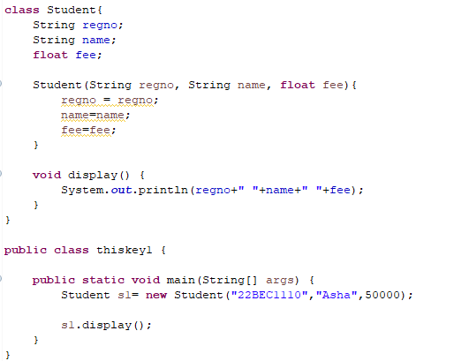
Example 1:
Output
0 null 0.0

Slide 19
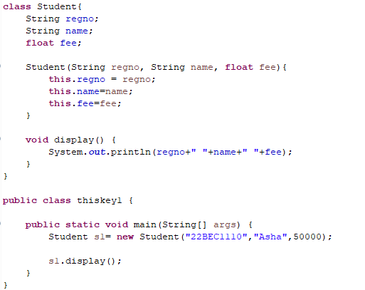
This - current class instance variable

Slide 20
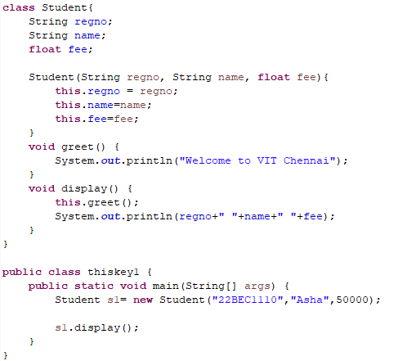
this – to invoke current class method

Slide 21
Static keyword
The static keyword in Java is used to define class-level members that belong to the class rather than instances (objects). It can be applied to:
Variable
Method
Block
Nested class

Slide 22
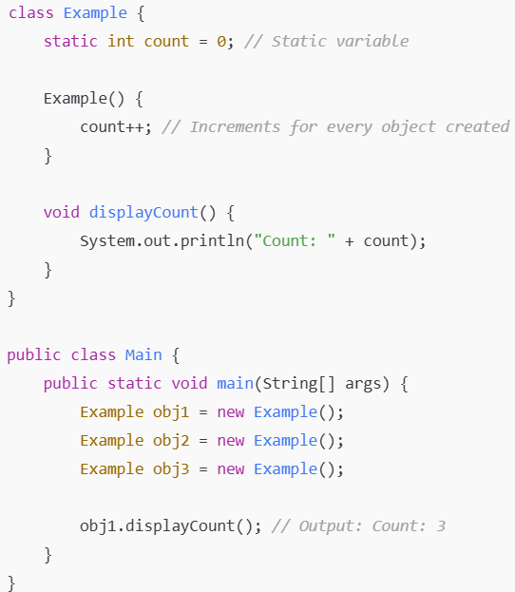
Static Variables (Class Variables)
A static variable belongs to the class and is shared by all objects.
It is stored in the method area and initialized only once when the class is loaded.

Slide 23
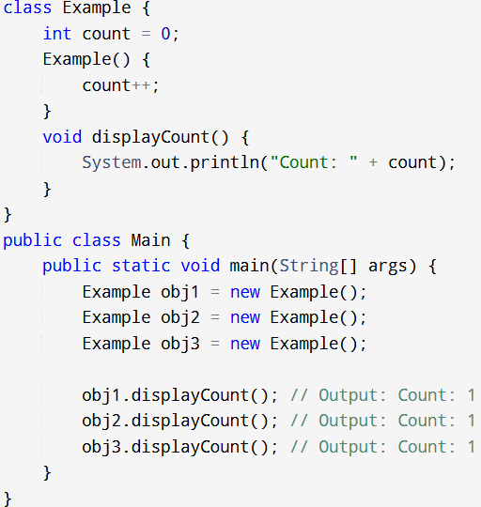

NON-STATIC VARIABLE
OUTPUT

Slide 24
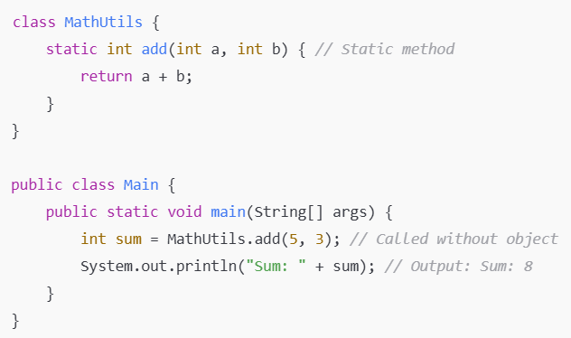
Static Methods
A static method belongs to the class, not the object.
It can be called without creating an object.
Cannot access non-static (instance) variables or methods directly.

Slide 25
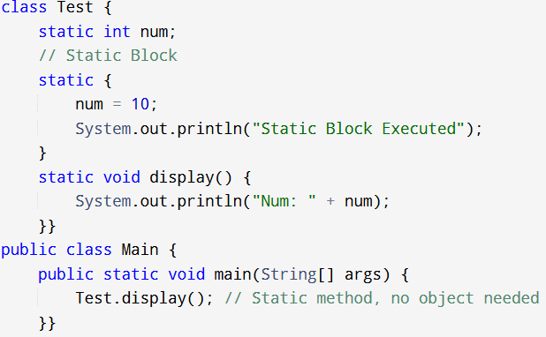

Static Block (Static Initializer)
Executed only once when the class is loaded into memory.
Used for initializing static variables.
OUTPUT

Slide 26
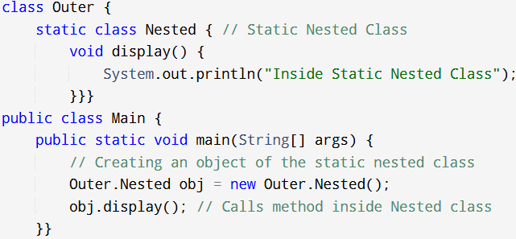
Static Nested Class
A static nested class (also called a static inner class) does not need an instance of the outer class.
It cannot access non-static members of the outer class.

Slide 27
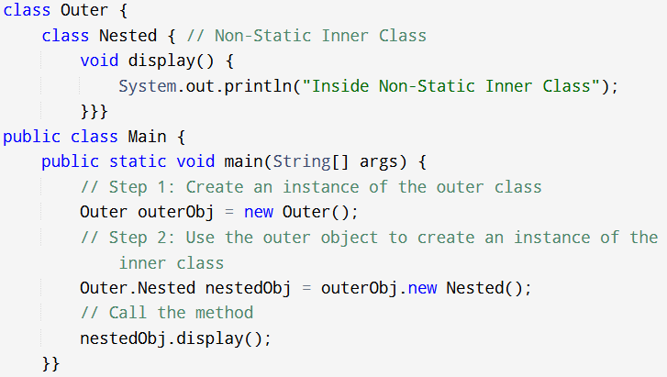

Slide 28
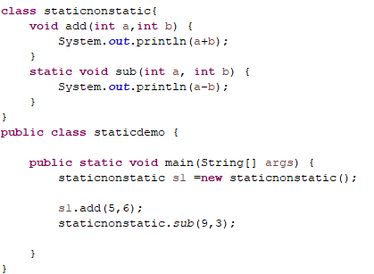

Slide 29
Constructor overloading
Constructors used should have different parameters ( either different numbers of parameters or different types of parameters).

Slide 30
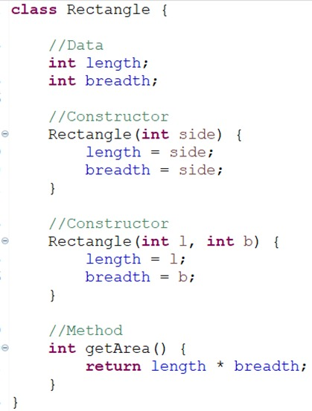
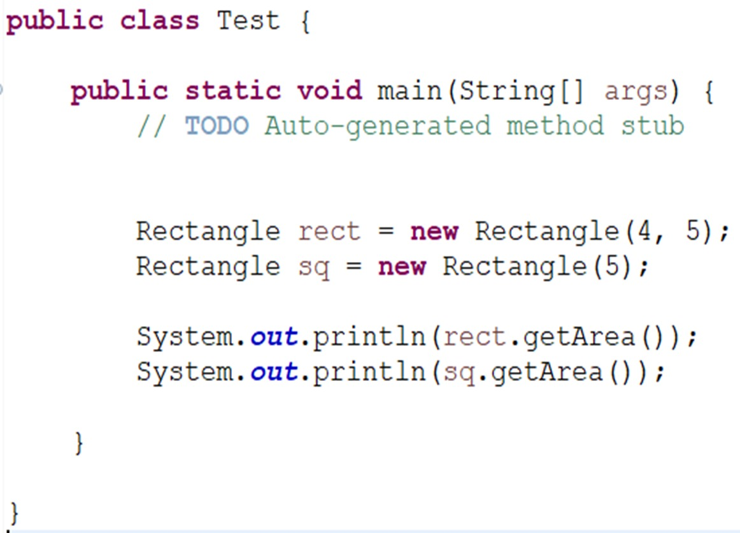

Slide 31
TRY
Create a class named Rectangle2 and create two objects and determine the area of the rectangle. Use parameterized constructs.
Write a Java program to calculate the perimeter of a square, triangle and rectangle.
Write a program to add, subtract, multiply and divide two numbers. Create methods for each, and the method multiply and divide should return value.
Write a Java program to classify the intensity of rainfall received in a week based on their average rainfall for a week. Get the daily rainfall in mm for the week. The intensity of rainfall is as follows: Return average rainfall.
Classification of rainfall | Average Rain fall in mm
No Rain | <= 0
Light | 0 < R <= 10.0
Moderate | 10.0 < R < 35.5
Rather Heavy | 35.5 < R <= 64.4
Heavy | 64.4 < R <= 124.4
Very Heavy | R > 124.4

